Slide 1
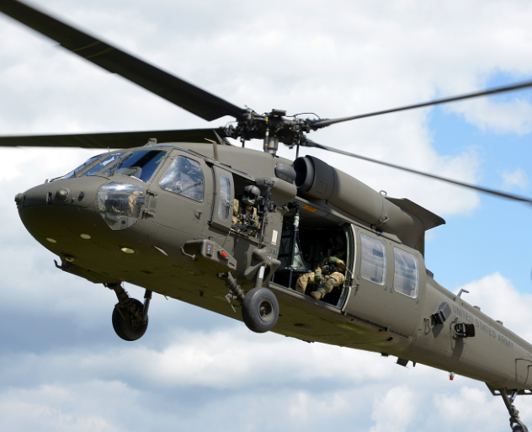
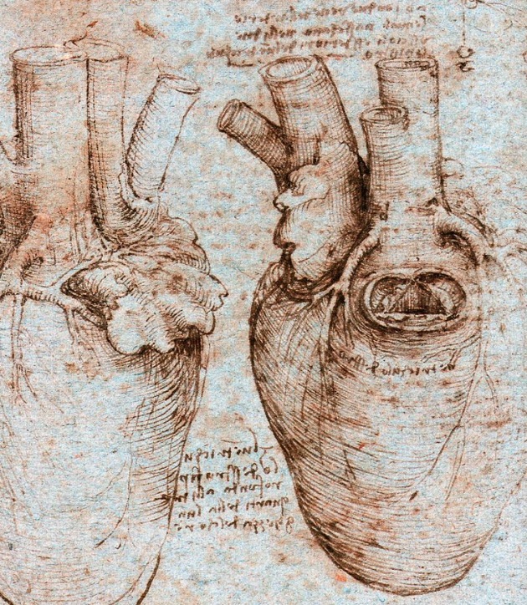
Baxter Healthcare ANZSCTS Educational Grant 2024: Innovation in Cardiothoracic Surgery Applicants must be Cardiothoracic SET Trainees, Younger Fellows or Unaccredited registrars 4 awards @ $5000 each (Categories: Cardiac, Thoracic, Trauma, Training) Applicants submit a 3 minute educational video for junior doctors on 1 of the following topics: 1. Cardiac valve surgery – the next frontier? 2. Thoracic malignancy surgery – to cut is to cure? 3. Haemorrhage control on the frontline – getting them out and alive 4. How to train future Cardiothoracic Surgeons Presentations should have a clinical focus. The winners will be announced at the 2024 Noosa ANZSCTS Annual Scientific Meeting conference dinner. Applications must be received 1800 November 1st 2024. Email submissions to nickdanes@anzscts.org

